Slide 1


JavaScript Applications for the Enterprise: Test More, Work Less
Esri Developer Summit
March 8–11, 2016 | Palm Springs, CA
George Bochenek
Randy Jones
Notes:
Good Morning I’m Randy Jones and this is George Bochenek. We work in esri’s professional services division helping clients to design and implement applications. Most of the time those applications are enterprise, workflow driven applications, which is just another way for saying big and we know that the larger the application the bigger chance is it will get out of control. So today we’re going to talk some about how to keep things under control by integrating testing into our applications.

Slide 2
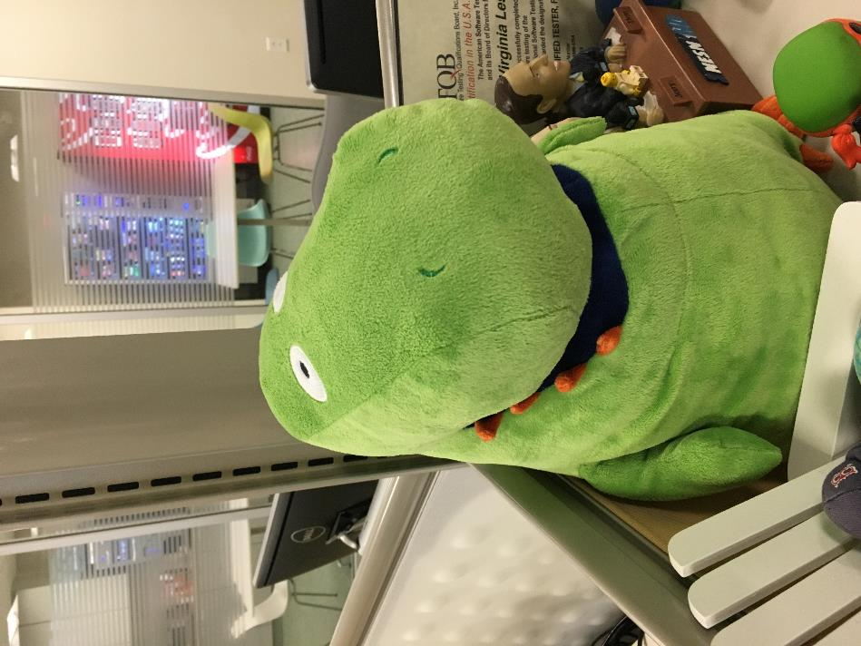
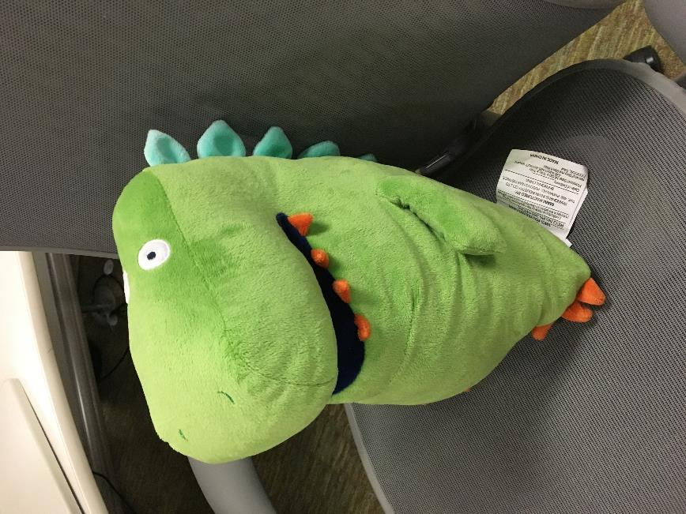
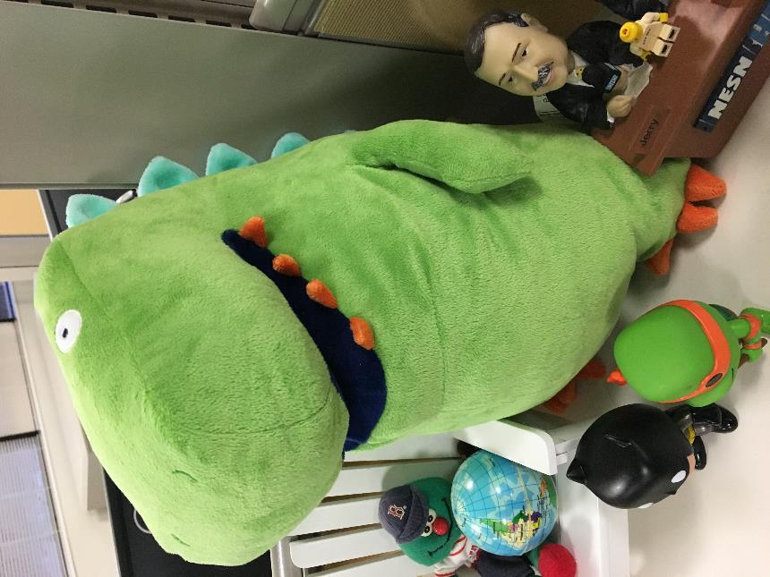
QA is Important
Notes:
Quality Assurance is important. Here we have our office’s Test-a-sarous. You don’t want to make him mad. He belongs to our QA team, who we also don’t want to make mad. And quite frankly we’re equally as frustrated if they find a bug that could have been easily avoided. We’re lucky that we have a dedicated QA team to help us ensure the quality of our software is high, but regardless if you have this luxury testing helps us ensure everyone is happy and our application quality is high.

Slide 3

Regressions and the Dream Curve
Notes:
Another perspective is monetary impact when our applications don’t work. The later in the software development cycle bugs are found or changes are made the more costly they become. If you create applications for clients most customers want warranty work done and you probably bid that part of your contract very low because well you think your code always works.

Slide 4

Regressions and the Dream Curve
Notes:
Then then there is also the perspective of the user. Users are extremely turned off applications that don’t work and aren’t likely to want to come use them again, which could have monetary impacts to your company or customers. Ultimately we all have pride as developers and we want to write good code and the QA process is part of what will help us to do that.

Slide 5

Enterprise Challenges
Notes:
Whenever I see a presentation on testing I always come away energized and ready to conquer the testing world. Then I get back to the office, look at my project, promptly craw under my desk and cry for awhile. Adding testing to any existing project is hard, but with large enterprise projects it can be just downright daunting. Where do you even start? George is going to start walking us through the types of testing and how we can start to get testing into our project by knowing what we should and shouldn’t test.

Slide 6


Unit Testing
wwworks/8081867203
Notes:
Before we can really get into testing, it helps to get some best practices under our belt. When we’re writing automated tests, there are two basic types to look at. Unit tests, and Functional tests. Functional tests aim to test the system as a more complete entity, from a user’s perspective. These tests are going to simulate button clicks, interact with web services and back-end components; Give us a complete view of how the system is functioning.
On the other hand, unit tests focus on the building blocks of your program. These are the tests that verify the code is doing what it’s meant to do and that individual parts are still functioning after every update. Unit tests are the work horse of any strong automated testing system and a well functioning suite can help keep regressions at bay.
The first time we went to apply tests to an enterprise project already in the works, we were super confused and did pretty much everything wrong. We wrote all of our unit tests like functional tests and created a ton of unnecessary work for ourselves along with making our tests way too fragile. In order to make unit test writing easier and the tests themselves more affective, there are a few basic principals to follow.

Slide 7

Don’t Test Other People’s Code
Aerokay/Tommy-the-Cheater-204152168
Notes:
In my mind, the biggest piece to get right (especially when working on things that use a lot of external dependencies, like ESRI JavaScript Applications) is to not test other people’s code. This means that we shouldn’t be checking to see if the map is at the right zoom level, or your MapService sent back an image. That sort of testing is the JavaScript API team’s job. They spend a lot of time on it, so we don’t have to. We just want to make sure our code is still working; we’ll trust the API team to ensure the map is still being redrawn when I call set Extent.
Instead, we just want too make sure the function got called.

Slide 8

Spies and Fakes
ajc1/6357759479
Notes:
So how do we get do that?
To ensure functions are being called without actually making network calls or digging into a library, we have something called spies and fakes. Since we’re writing most of these tests in JavaScript, this ends up being really easy. We can temporarily rewrite functions to do whatever we want. There are a number of different APIs that can help implementing this sort of set up. They usually include functions for testing whether a function was called, but its also easy to add quick Boolean checks or counters yourself.
When you’re not calling the real function, you’re not testing the JavaScript API.

Slide 9
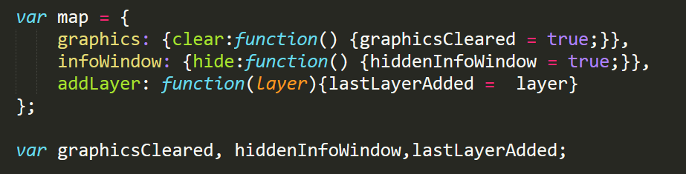

Slide 10

Encapsulation
cancunwijaya/15897251675
Notes:
Another big piece of the testing puzzle has to do with how your code is structured. By separating each bit of functionality into individual smaller functions, and separating the logic of our program from the actual actions, we can more easily ensure each piece is getting tested individually and each test has limited dependencies.
Now that we’ve got the basics under our belt, let’s get into it and see how these things actually work in practice.
DEMODEMODEMODEMO
What about something a little more complicated?

Slide 11

Functional Testing
nrcgov/6800272614
Notes:
While unit tests make up the bulk of our safe guards, its still important to have something to check a feature end to end, from a client’s perspective.
Functional tests are run using a test runner on the actual site. That means we’re going to try to interact with the application in our browser like a user would. Usually it goes a lot more smoothly than it did for this truck.
Let’s go through an example in our sample application: DEMODEMODEMO

Slide 12


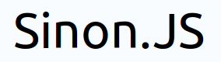

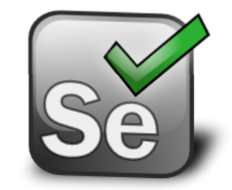

Notes:
When it comes time to actually start implementing this stuff on your own, there are a ton of different frameworks out there and every camp has their reason’s for one or the other. We’ve been using Intern with Selenium in this presentation, but if your team has experience with a framework or one just looks a little easier to implement, just go for it.
The cool thing about Intern, is that it comes with a number of the pieces built in, and has a lot of documentation geared towards dojo, but most frameworks out there are module, including intern, so any missing pieces can be bolted on after the fact. A lot of people use Sinon.JS, which helps to make spies and fakes easier to implement, there are add-ons that give some more options for assertion syntax. If you’re using Selenium to run functional tests, you’re going to have to download a driver for each browser that needs testing. [Add note about considering brower support when selecting testing framework]
We’ve added testing to a couple mature enterprise projects in the past and its definitely not easy. It can get a little overwhelming, but we’ve found taking the time to put this into practice makes a huge difference. The best way to do it is to start small. You can add a couple new unit tests each release, while using test driven development for any new features. Even a little bit of testing is going to be miles ahead of doing everything by hand.

Slide 13





Continuous Integration
Notes:
Now that we have our unit tests and we’ve know that we’re passing our code quality linting tests, how do we keep this occurring on a consistent basis and ensure that everyone’s code is passing these tests?
Your developers can utilize Grunt or Gulp to watch for changes on the javascript files in your project and run your tests and lint every time a change is made. But we want to take an extra step and make sure that everything that is committed to our source control repository is checked as well. So to do this we’ll take our grunt script and run it with a continuous integration server. There are many great ones out there Travis CI, Jenkins, Hudson

Slide 14
How do we Test?
Write Code
Write Test
Write code, break test
Rewrite Test
Notes:
So how do we write tests during development? Normally developers fall into a cycle similar to this.
They write code
then they write the test,
it passes and then they write more code
which breaks the test
So they rewrite the tests.
This is really a flawed method of development. More often than not our test aren’t based around the success criteria for the features we’re developing, they’re based around the code that we’ve written.

Slide 15
Test Driven Development
Write Test
Test Fails
Write code till passes
Refactor
Notes:
However, if we turn this upside down, we get what’s called Test driven development.
We start by writing a tests that begins to describe our success criteria,
we run our unit test and it should fail because we haven’t written any code yet.
Then we start to write code till it passes
and write our next test,
which again fails and we write code till it passes
then we refactor our code to remove duplication etc and continue this cycle
This way we’re letting the success criteria for our features drive our development and not declaring success based on what we’ve done.
However, I’ll be honest doing test driven development is hard. It can be difficult to get developers to buy into this process, but if your developers are testing only their code and make sure they are doing unit testing it can be an easier prospect.

Slide 16
Release Candidate
Some
Feature
Future
Feature
Time
1
2
Trunk
aka
Stable
3
Minor
Feature
4
5
6
Source Control
1.0
7
8
Update
9
1.1
10
11
Inspired from https://gist.github.com/digitaljhelms/4287848

Slide 17
Resources
https://github.com/Esri/enterprise-build-sample-js
JavaScript Mapping Applications - Testing Tools and Patterns
http://video.esri.com/watch/4281/javascript-mapping-applications-_dash_-testing-tools-and-patterns

Slide 18




